Slide 1
Assignment 5 Stability & RH Criteria
Nusair Islam

Slide 2
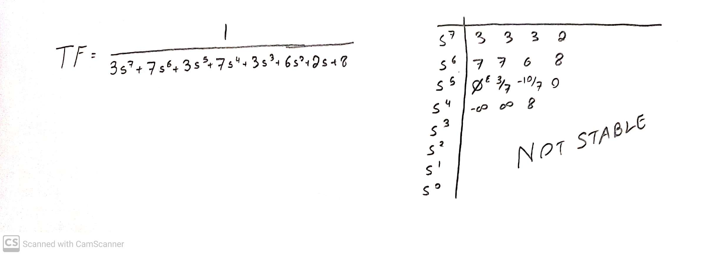
1. Use Routh-Hurwitz Criteria to determine if TF is BIBO Stable
A special case of the Routh-Herwitz Criteria stated that if there’s a 0 followed by other numbers, it’s not stable! Therefore, this TF is not stable. This is further shown when the next coefficient has a sign change, showing a RHP

Slide 3
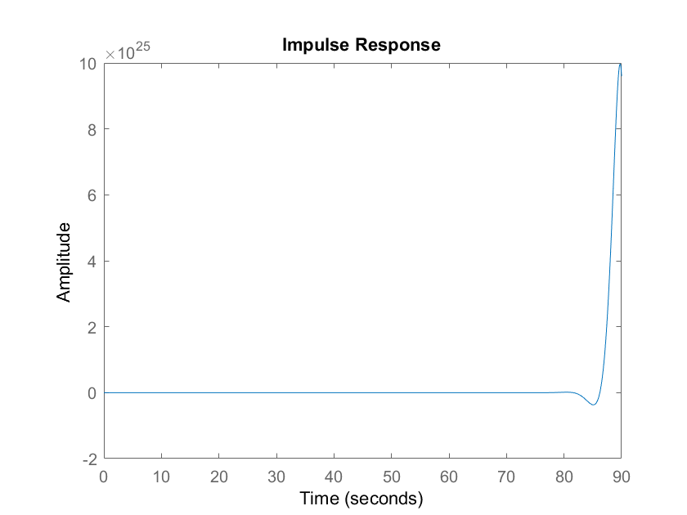
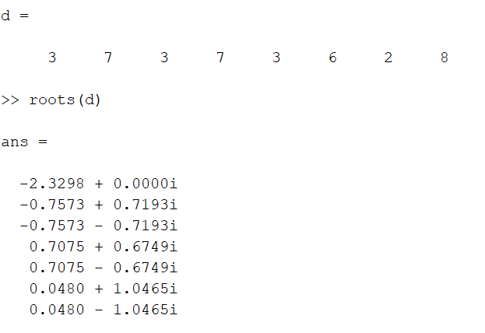
2. Verify previous answer on MATLAB
A pole cannot be located in the Right-Hand side of the jw axis. The above script shows the poles and there are some positive Real poles indicating it is located on the RH side. This causes the system to grow unbounded.
This impulse function further shows how unstable it is. As you can see, after the impulse response the system skyrockets with no signs of stability

Slide 4
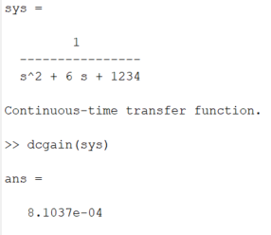
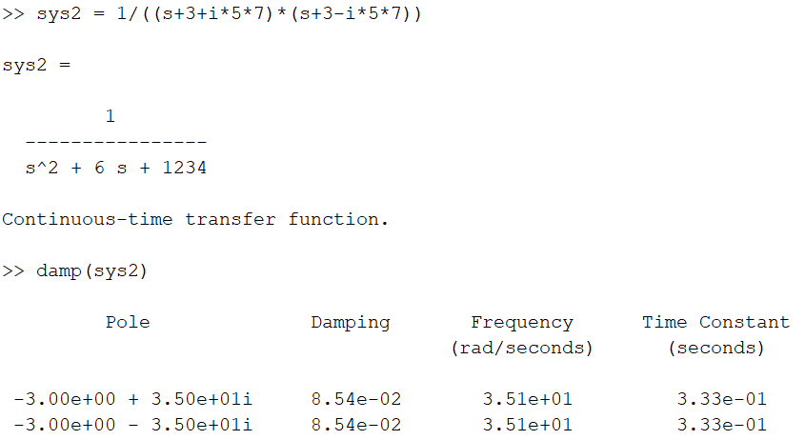
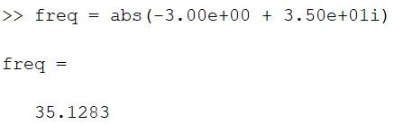
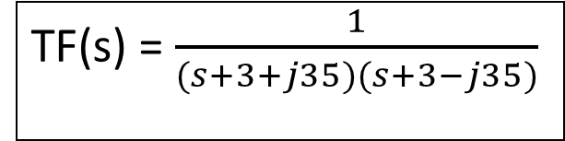
3. Find the following TF’s DC gain, freq, natural freq, and damping coefficient
TF(s) = $\frac{1}{(s+3+j35)(s+3−j35)}$
DC Gain
Damping Coeff.
Natural freq.
Actual freq.

Slide 5
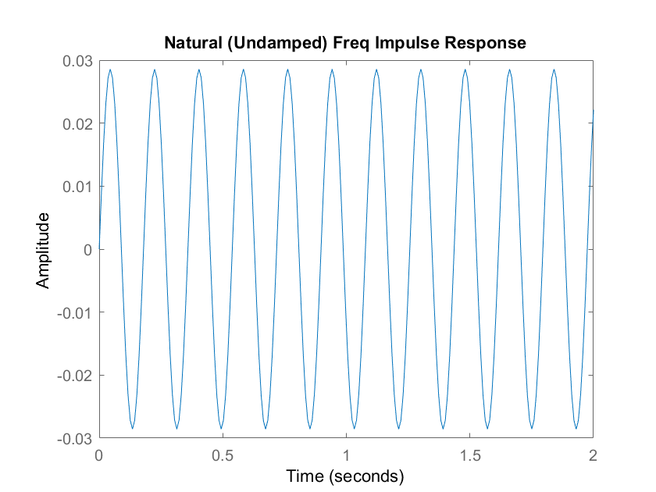
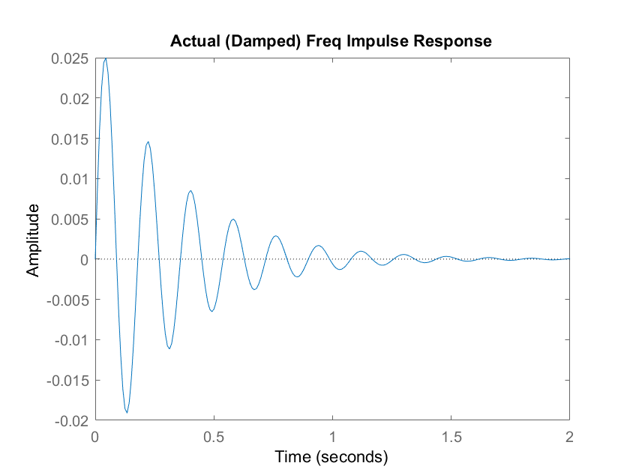
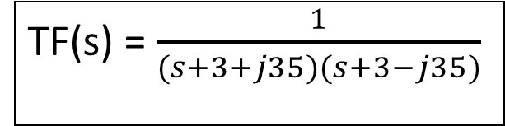
4. Impulse Responses of the ACTUAL and NATURAL freq.
TF(s) = $\frac{1}{(s+3+j35)(s+3−j35)}$

Slide 6
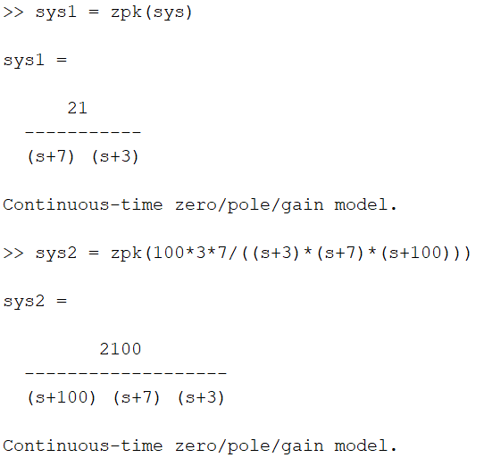
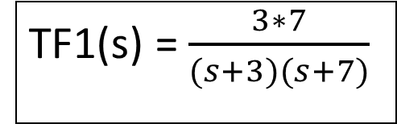
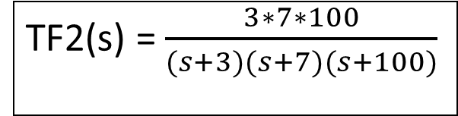
5. MATLAB zpk of TF1 and TF2
TF1(s) = $\frac{3∗7}{(s+3)(s+7)}$
TF2(s) = $\frac{3∗7∗100}{(s+3)(s+7)(s+100)}$

Slide 7
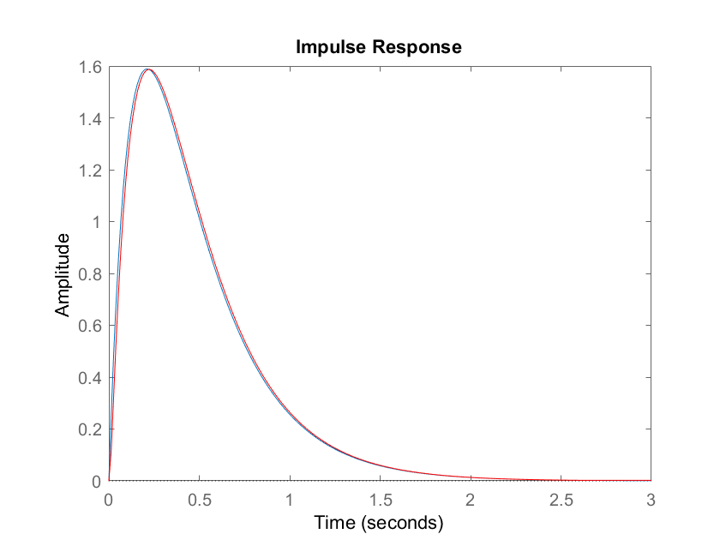
5. Impulse Response of TF1 and TF2

Slide 8
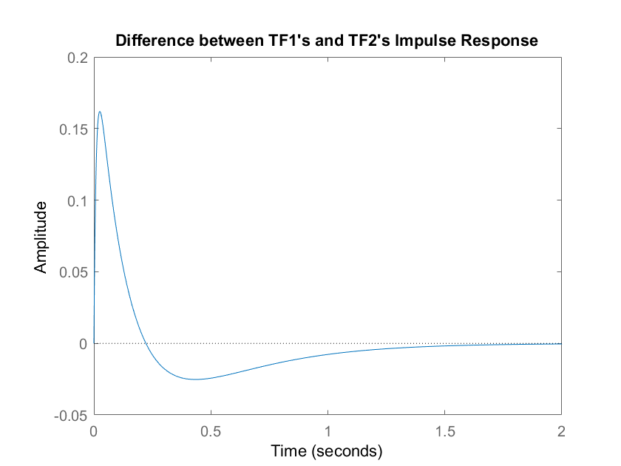
6. Impulse Response difference of TF1 and TF2 from prev. part
The difference between the two impulse functions is very low. This figure shows that after about 1.5s, the two impulse functions behave almost the same. After the impulse is applied there is a slight difference most likely because of TF2’s extra pole at -100
The pole s = -100 is a non-dominant pole because, the dominant pole is s = -3 since it is the smallest pole, and 100 > 3*10, therefore the contribution of s = -100 is almost non-existent
But that non-existant pole is the reason why there is a small discrepancy at first, although it goes away very quickly.

